Slide 1
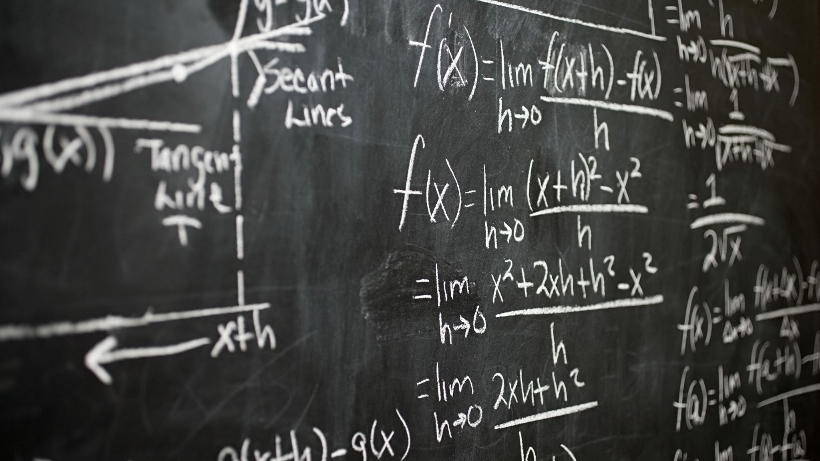
Mathematics for intelligent systems-3
Assignment 1

Slide 2
Team 2
Ananya K –CH.EN.U4AIE21105
Amirthavarshini –CH.EN.U4AIE211
Hrishikeasan - –CH.EN.U4AIE21116
Abhay Nanduri –CH.EN.U4AIE21130
Viswanathan V –CH.EN.U4AIE21164

Slide 3
Eigen values and Eigen Vectors
Geometric Definition
Eigen Equation
Arithmetic Multiplicity and Geometric Multiplicity

Slide 4















Slide 5
















Slide 6
















Slide 7















The Eigen Equation

Slide 8

















Slide 9








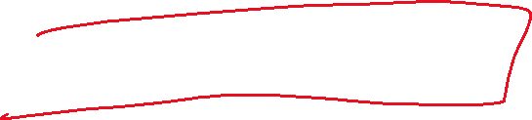













Slide 10





















